Slide 2
Digital Forensics
Legal Hold
Data acquisition and preservation is important
Notes:
How we preserve the data is crucial
With an ever-growing amount of data
Constantly being modified, deleted, the organization will

Slide 3
Digital Forensics Concepts
Right-to audit clauses
Regulatory and jurisdiction
Data breach notification
Notes:
Right-to-audit (Part of a contract between a cloud provider and customer organization that allows for auditability
Most cloud providers will not allow this and hire third-party auditing agencies
Regulatory and jurisdiction – local, state, territorial, federal and international considerations
Data breach notification – the amount of time that can pass before an org is required to inform customers

Slide 4
Digital Forensics – Data Acquisition
Order of Volatility
CPU cache,
registers
Routing table, process table, ARP cache, kernel stats
Random-access memory
Swap file, page file (temp files)
Disk (HDD, SSD), snapshots
Archival data, backups
Notes:
How do we determine what to acquire first or where do we start

Slide 5
Digital Forensics – Data Preservation and Documentation
Time stamps
Time offset
Reports and event logs
Interviews

Slide 6
Digital Forensics – Data Preservation and Documentation
Integrity
Hashing
Checksums
Provenance
Notes:
Provenance - digital provenance is an unforgeable record of a digital object's chain of successive custody and (timeline of sequence of events)sequence of operations performed on the object.

Slide 7
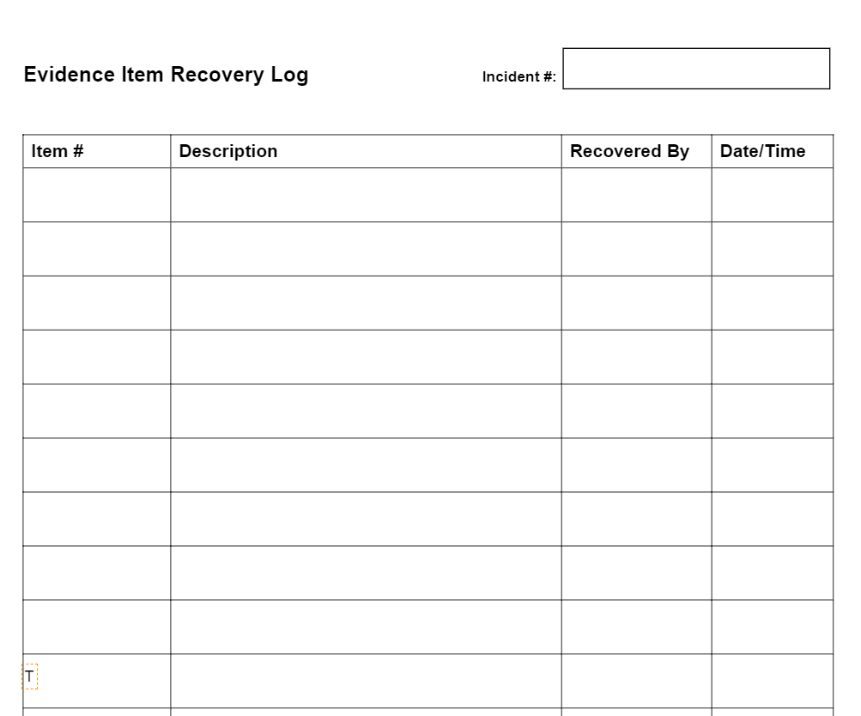
Digital Forensics – Chain of Custody
Notes:
https://edrm.net/edrm-model/ (E-discovery and Reference Model)

Slide 8
Digital Forensics - Tools
dd
memdump
FTK Imager
WinHex
Autopsy
EnCase
Notes:
https://www.sleuthkit.org/autopsy/#:~:text=Autopsy%C2%AE%20is%20a%20digital,from%20your%20camera's%20memory%20card.
https://accessdata.com/products-services/forensic-toolkit-ftk/ftkimager#:~:text=FTK%C2%AE%20Imager%20is%20a,%C2%AE%20(FTK)%20is%20warranted.
https://www.x-ways.net/winhex/
EnCase - https://security.opentext.com/encase-forensic

